Slide 1




Course Name: Problem Solving Using Computers
B.TECH FIRST YEAR
Academic YEAR: 2024-2025
Course code : CS 1002
Lecture series no : 01
Credits : 3
Faculty : Dr.Jeyakrishnan.V
Email-id : Jeyakrishnan.v@jaipur.manipal.edu

Slide 2
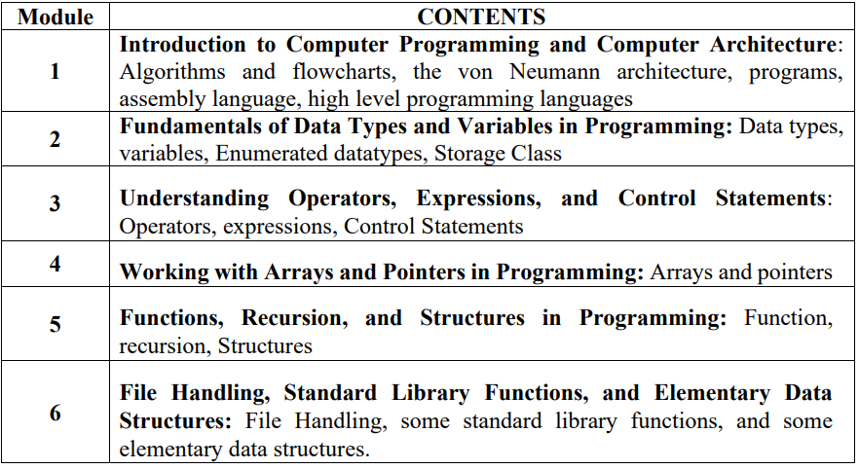
Problem Solving Using Computers Subject Code: CS1002
First Module:
Digital computer fundamentals: Algorithms and flowcharts, the von Neumann architecture, programs, assembly language, high level programming languages.

Slide 3
Digital computer
A digital computer is a digital system that performs various computational tasks and represented by variables with the limited number of discrete values.
The discrete values are internally processed with limited number of discrete states. The decimal digits 0,1,2,…,9 provide 10 discrete values. Mostly all discrete values are available in the form of American Standard Code for Information Interchange (ASCII)
Where the first electronic digital computers developed in 1940. From here the term digital computer emerged because of many restrictions with other discrete values.

Slide 4
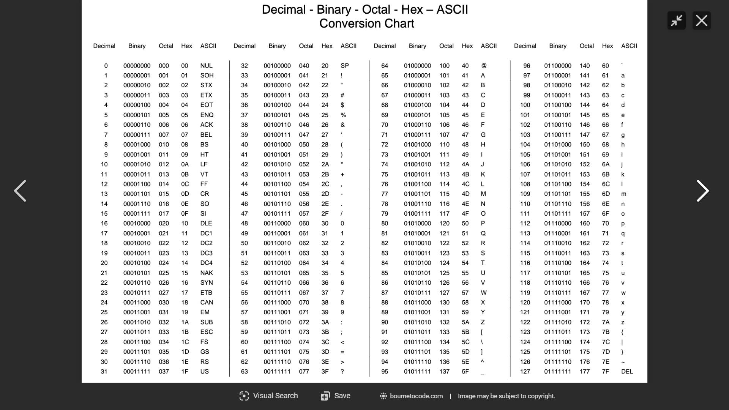

Slide 5
Functional Units of Computer System
It is divided in two modules in general:
Hardware: A hardware of the computer system consists of all electronic components such as electronic circuits, display units, storage media (magnetic and optical (a class of data storage systems that use light to read or write data to an underlying optical media-CD, DVD)), electromechanical devices and communication facilities.
Software: It consists of the instructions and data that the computer manipulates to perform various data-processing tasks. Where sequence of instruction is called a program.
Von Neuman and Harvard Architecture ( Data and Program)

Slide 6
Von Neumann Architecture(Stored Memory Program)
Von-Neumann computer architecture design was proposed in 1945. It was later known as Von-Neumann architecture.
Historically there have been 2 types of Computers:
Fixed Program Computers – Their function is very specific and they couldn’t be reprogrammed, e.g. Calculators.
Stored Program Computers – These can be programmed to carry out many different tasks, applications are stored on them, hence the name is.

Slide 7
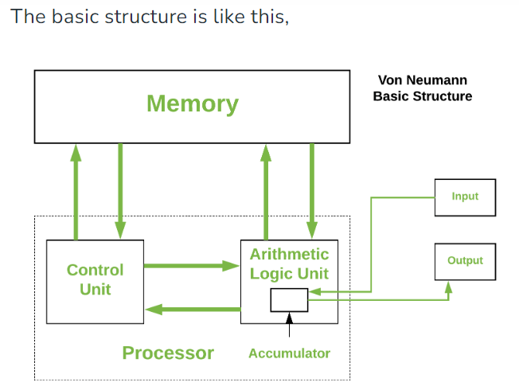
Von Neumann architecture… Cont’d
Modern computers are based on a stored-program concept introduced by John Von Neumann.
In this stored-program concept, programs and data are stored in a separate storage unit called memories and are treated the same.
This novel idea meant that a computer built with this architecture would be much easier to reprogram.
Notes:
The accumulator is an 8-bit arithmetic/logic unit (ALU) register. This register is used to store 8-bit data as well as arithmetic and logical operations. The accumulator stores the result of an operation

Slide 8
Von Neumann architecture is also known as ISA (Instruction set architecture) computer and is having three basic units: Central Processing Unit (CPU), Main Memory Unit and Input/Output Unit.
1. Central Processing Unit-
The central processing unit is defined as an electric circuit used for the executing the instruction of computer program. It has following major components:
1.Control Unit(CU)
2.Arithmetic and Logic Unit(ALU)
3.variety of Registers
Control Unit – A control unit (CU) handles all processor control signals. It directs all input and output flow, fetches code for instructions, and controls how data moves around the system.
Arithmetic and Logic Unit (ALU) – The arithmetic logic unit is that part of the CPU that handles all the calculations the CPU may need, e.g. Addition, Subtraction, Comparisons. It performs Logical Operations, Bit Shifting Operations, and Arithmetic operations.

Slide 9
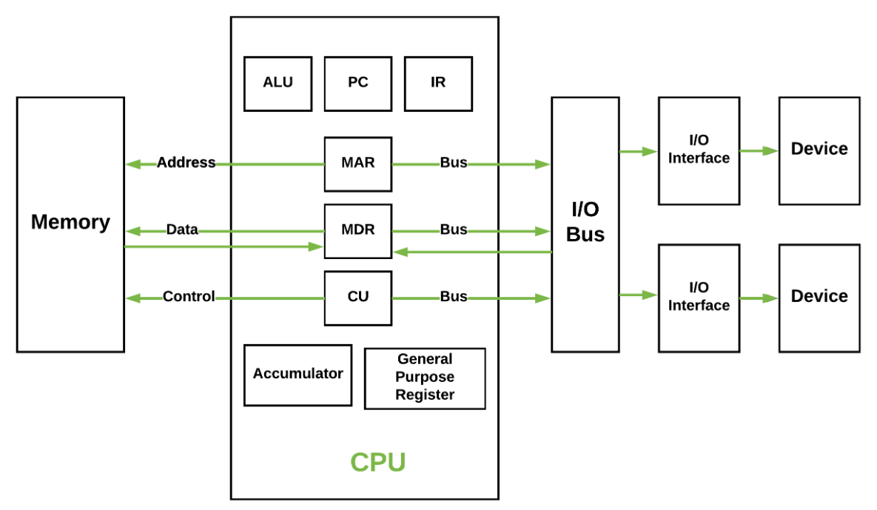
Basic CPU structure, illustrating ALU
Notes:
The accumulator is an 8-bit arithmetic/logic unit (ALU) register. This register is used to store 8-bit data as well as arithmetic and logical operations. The accumulator stores the result of an operation

Slide 10
Registers
Registers – Registers refer to high-speed storage areas in the CPU. The data processed by the CPU are fetched from the registers. There are different types of registers used in architecture :-Accumulator: Stores the results of calculations made by ALU. It holds the intermediate of arithmetic and logical operatoins.it act as a temporary storage location or device.
Program Counter (PC): Keeps track of the memory location of the next instructions to be dealt with. The PC then passes this next address to the Memory Address Register (MAR).
Memory Address Register (MAR): It stores the memory locations of instructions that need to be fetched from memory or stored in memory.
Memory Data Register (MDR): It stores instructions fetched from memory or any data that is to be transferred to, and stored in, memory.
Current Instruction Register (CIR): It stores the most recently fetched instructions while it is waiting to be coded and executed.
Instruction Buffer Register (IBR): The instruction that is not to be executed immediately is placed in the instruction buffer register IBR.

Slide 11
Input and Output Unit
Input: Computer accept coded information through input unit. The most common device is Keyboard. Whenever key is pressed, the corresponding letter or digit is automatically translated into its corresponding binary code and transmitted over a cable to either memory or the processor.
Output: The output unit is the counterpart of the input unit. Its function is to send processed results to the outside world. The most familiar device is a printer. Some units, such as graphical displays, provide both an input and output function.

Slide 12
Memory
The function of the memory unit is to store programs and data. There are two classes of storage, called as Primary and Secondary.
Primary storage is a fast memory. The memory contains large number of semiconductor storage cells, each cell capable of one bit of information. These cells are rarely used as an individual cell instead are processed in group of fixed size, called words.
To provide an easy access of any word in memory, a distinguished address is associated with each word location. Addresses are numbers that identify successive locations. The typical word lengths range from 16 to 64 bits.
Memory in which any location can be accessed in short and fixed amount of time after specifying address is called Random Access Memory (RAM). CPU is known as RAM because CPU can access any locations at any point of time.

Slide 13
Memory Con’d
The smaller and fasted unit is called Cache. The largest and slowest unit is referred to as main memory.
Although primary storage is essentials and expensive. But in addition to the same cheaper memory is available as a secondary memory storage, where large amount of data and many programs may be stored.
A wide range of secondary storage are available in the form of magnetic disks, tapes and opticals disks (CD-ROMS).

Slide 14
Memory unit
The computer memory is measured in terms of bits, bytes and words.
A bit is a binary digit either 0 or 1.
A byte is unit of memory and is defined as sequence of 8 bits.
The word can be defined as a sequence of 16/32/64 bits or 2/4/8 bytes respectively depending on the machine architecture
Notes:
Additional notes on memory units
The computer’s memory stores data, instructions required during the processing of data, and output results. Storage may be required for a limited period of time, instantly, or, for an extended period of time. Different types of memories, each having its own unique features, are available for use in a computer. The cache memory, registers, and RAM are fast memories and store the data and instructions temporarily during the processing of data and instructions. The secondary memories like magnetic disks and optical disks have large storage capacities and store the data and instructions permanently, but are slow memory devices. The memories are organized in the computer in a manner to achieve high levels of performance at the minimum cost.

Slide 15
Primary storage: RAM & ROM
RAM stands for Random Access Memory
Read and write memory
Information typed by the user are stored in this memory
Any memory location can be accessed directly without scanning it sequentially (random access memory)
During power failure the information stored in it will be erased → volatile memory
ROM stands for Read Only Memory
Permanent memory and non volatile
Contents in locations in ROM can not be changed
Stores mainly stored program and basic input output system programs

Slide 16
Secondary memory
Main memory is volatile and limited
Hence it is essential for other types of storage devices where programs and data can be stored when they are no longer being processed
Installed within the computer at the factory or added later as needed
Notes:
Additional notes on secondary storage devices
Secondary memory on a computer is storage for data and programs not in use at the moment. In addition to punched cards and paper tape, early computers also used magnetic tape for secondary storage. Tape is cheap, either on large reels or in small cassettes, but has the disadvantage that it must be read or written sequentially from one end to the other

Slide 17
Secondary memory
Non-volatile memory
Made up of magnetic material
Stores large amount of information for long time
Low speed
Holds programs not currently being executed
Notes:
Input, output, and auxiliary/secondary storage devices attached to a computer are called peripherals. E.g. Magnetic tapes, magnetic disks, compact disks etc.

Slide 18
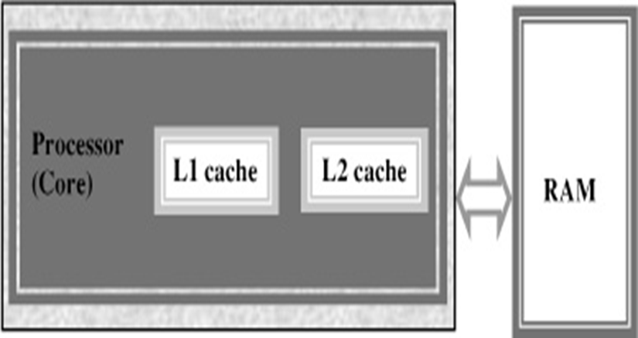
Cache memory
High speed memory placed between CPU and main memory
Stores data and instructions currently to be executed
More costlier but less capacity than main memory
Users can not access this memory
Notes:
Additional notes on cache memory
The data and instructions that are required during the processing of data are brought from the secondary storage devices and stored in the RAM. For processing, it is required that the data and instructions are accessed from the RAM and stored in the registers. The time taken to move the data between RAM and CPU registers is large. This affects the speed of processing of computer, and results in decreasing the performance of CPU.
Cache memory is a very high speed memory placed in between RAM and CPU. Cache memory increases the speed of processing.
Cache memory is a storage buffer that stores the data that is used more often, temporarily, and makes them available to CPU at a fast rate. During processing, CPU first checks cache for the required data. If data is not found in cache, then it looks in the RAM for data.
To access the cache memory, CPU does not have to use the motherboard’s system bus for data transfer. (The data transfer speed slows to the motherboard’s capability, when data is passed through system bus. CPU can process data at a much faster rate by avoiding the system bus.)
Cache memory is built into the processor, and may also be located next to it on a separate chip between the CPU and RAM. Cache built into the CPU is faster than separate cache, running at the speed of the microprocessor itself. However, separate cache is roughly twice as fast as RAM.
The CPU has a built-in Level 1 (L1) cache and Level 2 (L2) cache. In addition to the built-in L1 and L2 cache, some CPUs have a separate cache chip on the motherboard. This cache on the motherboard is called Level 3 (L3) cache. Nowadays, high-end processor comes with built-in L3 cache, like in Intel core i7. The L1, L2 and L3 cache store the most recently run instructions, the next ones and the possible ones, respectively. Typically, CPUs have cache size varying from 256KB (L1), 6 MB (L2), to 12MB (L3) cache.

Slide 19
Buses – Data is transmitted from one part of a computer to another, connecting all major internal components to the CPU and memory.
Types:
Data Bus: It carries data among the memory unit, the I/O devices, and the processor.
Address Bus: It carries the address of data (not the actual data) between memory and processor.
Control Bus: It carries control commands from the CPU (and status signals from other devices) in order to control and coordinate all the activities within the computer.

Slide 20
High level Programming Languages
In computer science, a high-level programming language is a programming language with strong abstraction from the details of the computer.
In contrast to low-level programming languages, it may use natural language elements, be easier to use, or may automate (or even hide entirely) significant areas of computing systems (e.g. memory management), making the process of developing a program simpler and more understandable than when using a lower-level language.
The amount of abstraction defines how "high-level" a programming language is provided.

Slide 21
Difference between High Level and Low level languages
Both High level language and low level language are the programming languages’s types.
The main difference between high level language and low level language is that programmers can easily understand or interpret or compile the high level language in comparison of machine.
On the other hand, Machine can easily understand the low level language in comparison of human beings. Examples of high level languages are C, C++, Java, Python, etc.

Slide 22
Difference between High Level and Low-level language
High Level Language Low-level language
1. | It is programmer friendly language. | It is a machine friendly language.
2. | High level language is less memory efficient. | Low level language is high memory efficient.
3. | It is easy to understand. | It is tough to understand.
4. | Debugging is easy. | Debugging is complex comparatively.
5. | It is simple to maintain. | It is complex to maintain comparatively.
6. | It is portable. | It is non-portable.
7. | It can run on any platform. | It is machine-dependent.
8. | It needs compiler or interpreter for translation. | It needs assembler for translation.
9. | It is used widely for programming. | It is not commonly used now-a-days in programming.

Slide 23
Compiler
A Translator (compiler) is a program that reads a program written in one language, the source language, - and translate it into an equivalent program in another language, the target language.
In computing, a compiler is a computer program that translates computer code written in one programming language (the source language) into another language (the target language).
The name "compiler" is primarily used for programs that translate source code from a high-level programming language to a low-level programming language (e.g. assembly language, object code, or machine code) to create an executable program

Slide 24
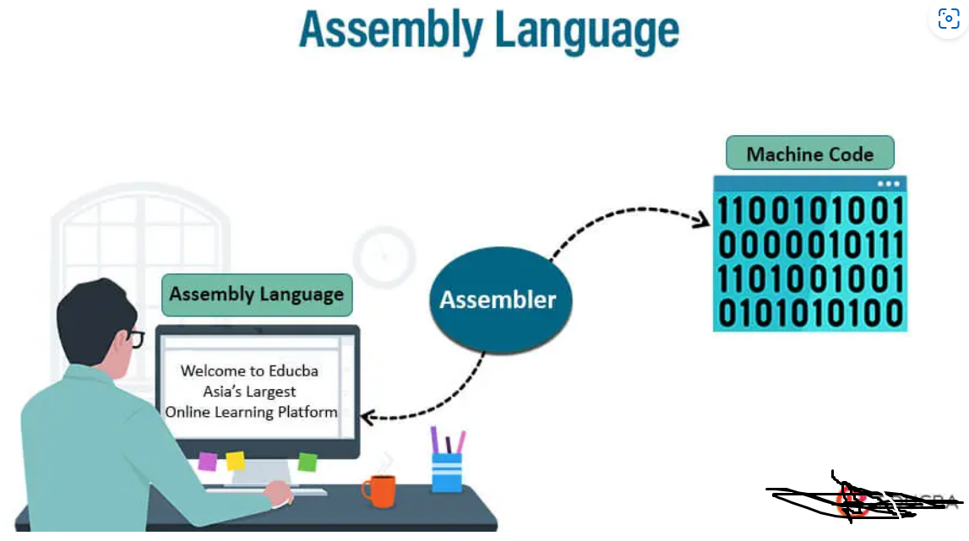
Assembly Language Assembly Language is a low-level programming language. It helps in understanding the programming language of machine code.
Machine code is a series of instructions that provide the necessary information to a user’s CPU to carry out a particular task (add, subtract, compare values, etc.).
In computers, there is an assembler that helps in converting the assembly code into machine code executable.
It establishes with the help of compiling high-level language source code like C and C++.
It mainly depends on the system architecture, whether it is an operating system or computer architecture to add assembler?

Slide 25
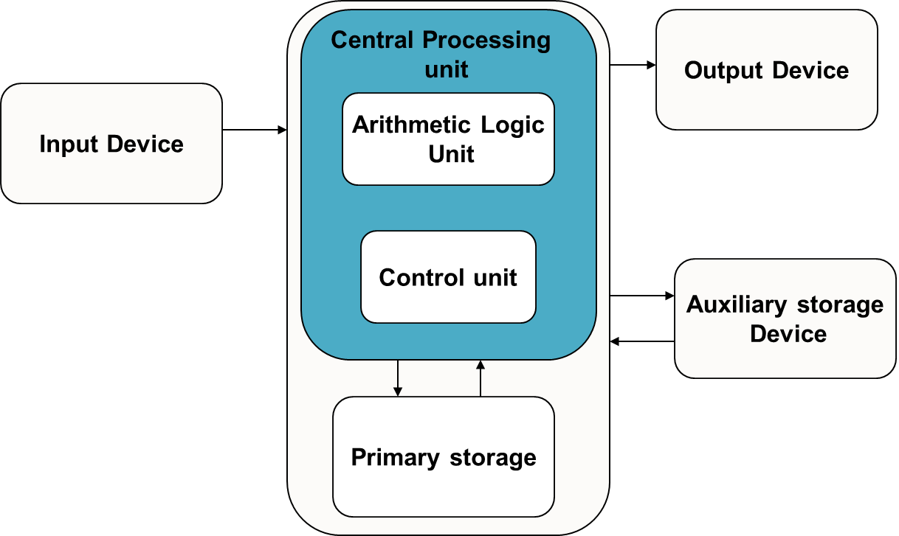
Computer Organization
Notes:
Additional notes on computing process information
A computer can process data, pictures, sound and graphics. They can solve highly complicated problems quickly and accurately. There are basically five major computer operations or functions irrespective of their size and make. They are
1) It accepts data or instructions by way of input,
2) It stores data,
3) It can process data as required by the user,
4) It gives results in the form of output, and
5) It controls all operations inside a computer.
Computer operations
1. Input: This is the process of entering data and programs in to the computer system. You should know that computer is an electronic machine like any other machine which takes as inputs raw data and performs some processing giving out processed data. Therefore, the input unit takes data from us to the computer in an organized manner for processing.
2. Storage: The process of saving data and instructions permanently is known as storage. Data has to be fed into the system before the actual processing starts. It is because the processing speed of Central Processing Unit (CPU) is so fast that the data has to be provided to CPU with the same speed. Therefore the data is first stored in the storage unit for faster access and processing. This storage unit or the primary storage of the computer system is designed to do the above functionality. It provides space for storing data and instructions.
The storage unit performs the following major functions:
• All data and instructions are stored here before and after processing.
• Intermediate results of processing are also stored here.
3. Processing: The task of performing operations like arithmetic and logical operations is called processing. The Central Processing Unit (CPU) takes data and instructions from the storage unit and makes all sorts of calculations based on the instructions given and the type of data provided. It is then sent back to the storage unit.
4. Output: This is the process of producing results from the data for getting useful information. Similarly the output produced by the computer after processing must also be kept somewhere inside the computer before being given to you in human readable form. Again the output is also stored inside the computer for further processing.
5. Control: The manner how instructions are executed and the above operations are performed. Controlling of all operations like input, processing and output are performed by control unit. It takes care of step by step processing of all operations inside the computer.

Slide 26
Operating System
OS is an integrated collection of programs which make the computer operational and help in executing user programs.
It acts as an interface between the man and machine.
It manages the system resources like memory, processors, input-output devices and files.
Windows, Linux, DOS

Slide 27
Computer Languages
Machine Language- The only programming language available in earlier days
Consists of only 0’s and 1’s; e.g.:- 10101011
Symbolic language or Assembly language-
symbols or mnemonics are used to represent instructions
hardware specific
e.g. ADD X,Y; Add the contents of y to x
High-level languages- English like language using which the programmer can write programs to solve a problem.
more concerned with the problem specification
not oriented towards the details of computer
e.g.: C, C++, C#, Fortran, BASIC, Pascal etc.

Slide 28
Language Translator
Compiler : Program that translates entire high level language program into machine language at a time. e.g.:- C, C++ compilers.
Interpreter : Program which translates one statement of a high level language program into machine language at a time and executes it. ,
e.g.:- Basic Interpreters, Java Interpreters.
Assembler : Program which translates an assembly language program into machine language.
e.g.:- TASM(Turbo ASseMbler), MASM(Macro ASseMbler).

Slide 29
History of C
The C language was evolved by Dennis Ritchie at Bell Laboratories and was originally implemented on a DEC PDP(Digital Equipment Corporation-Programmed Data Processor)-11 computer in 1972.
C initially became widely known as the development language of the UNIX operating system.
Today, virtually all new major operating systems are written in C and/or C++.
C is available for most computers.
C is mostly hardware independent.

Slide 30
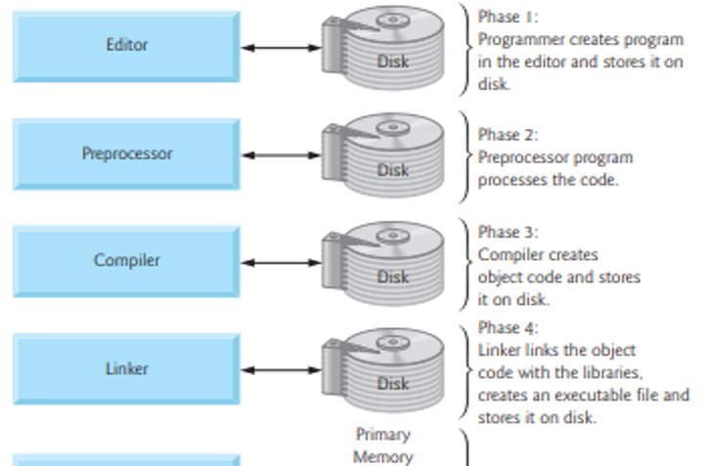
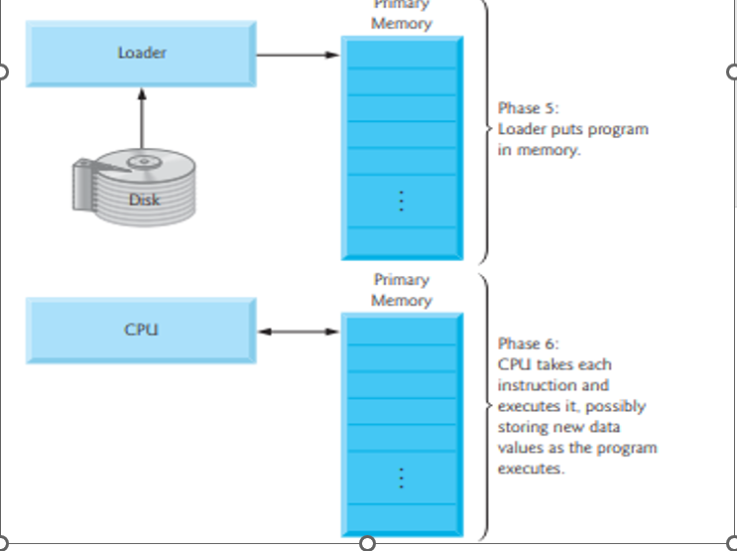
Typical C program development environment

Slide 31
Objectives
To learn and appreciate the following concepts
Problem solving basics
Logic and its importance in problem solving
Various computational problems and its classification
Computer Organization and operating system
Different types of languages
History of C, Typical C program development environment.

Slide 32
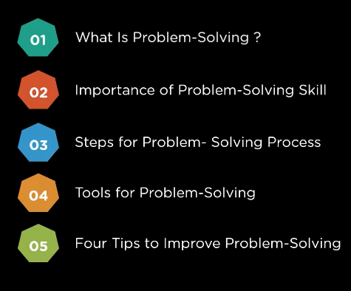

Slide 33
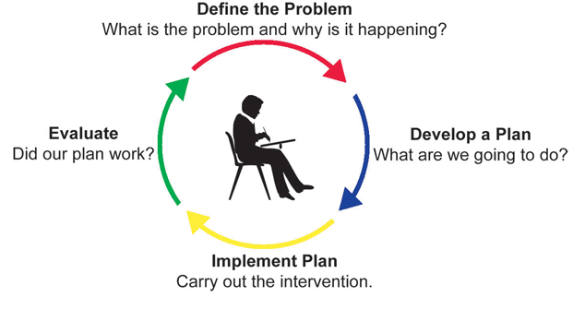
Introduction to problem solving
Notes:
Additional notes on problem solving
A problem exists when there is a situation you want to resolve but no solution is readily apparent. Problem solving is the process by which the unfamiliar situation is resolved. A situation that is a problem to one person may not be a problem to someone else.

Slide 34


Slide 35
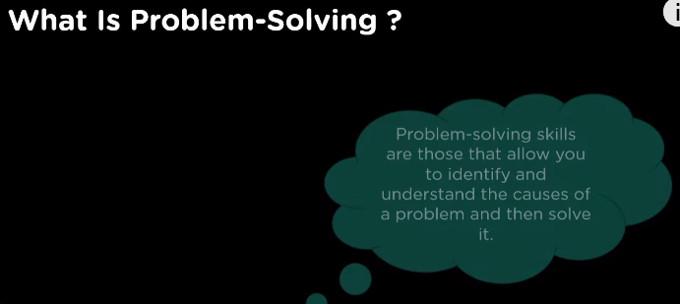


Slide 36
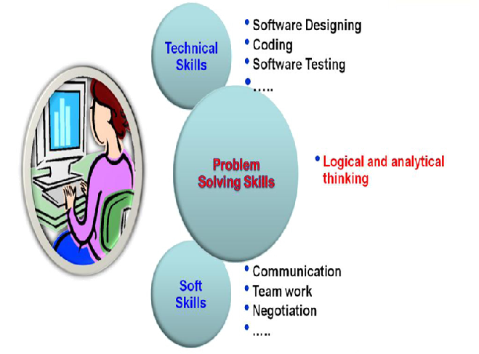
Skill set required for Software Engineers
Notes:
Additional notes on problem solving skills
Problem solving Skill is the key skill required for a software engineer as it helps to develop technical as well as soft skills.
Logical Thinking
Thinking in terms of cause and consequences
Sequential thinking
Means following a train of thought
Helps in decision making and problem solving

Slide 37

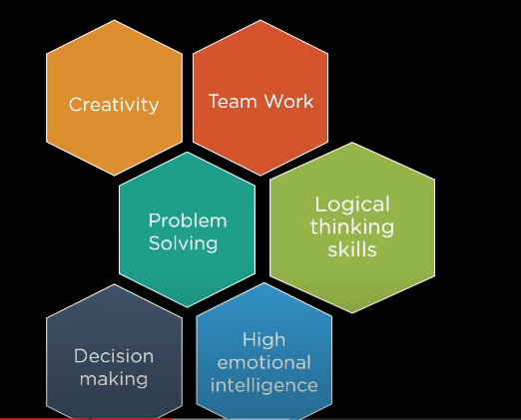

Slide 38
What is a problem?
A problem is a puzzle that requires logical thought or mathematics to solve
A puzzle could be a set of questions on a scenario which consists of description of reality and a set of constraints about the scenario
Eg: Scenario- Infosys Mysore campus has a library. The librarian issues book only to Infosys employees.
Description of reality: There is a library in Infosys Mysore campus . There is a librarian in the library
Constraints: librarian issues book only to Infosys employees.
Questions about the scenario: How many books are there in the library? How many books can be issues to an employee?
Does the librarian issue book to himself? Etc.

Slide 39

Logic
A method of human thought that involves thinking in a linear, step by step manner about how a problem can be solved
Logic is a language for reasoning. It is a collection of rules we use when doing reasoning.
Eg: John’s mother has four children.
First child is April
Second child is May
Third child is June
What is the name of fourth child?

Slide 40
Importance of logic in problem solving
Solution for any problem(eg: summation of two numbers) requires three things.
Input: Input values(Eg: 3 and 2)
Process: Process of summation
Output: Output after process (Eg: sum of numbers,5)
The process part(Eg: summation) of the solution requires logic( How to sum) or in other words based on the logic, process is developed.

Slide 41
Importance of logic in problem solving
For solving a problem, there may be multiple valid logics, some may be simple and some may be complex.
Eg: To determine whether the number is prime or not.
Logic 1- divide the number by all the numbers starting from 2 to one less than the number and if for all the division operations, the reminder is non zero, the number is prime. Else the number is not prime.
Logic 2 – same as logic 1 but divide the number from 2 to number/2
Logic 3 - same as logic 1 but divide the number from 2 to square root of the number

Slide 42
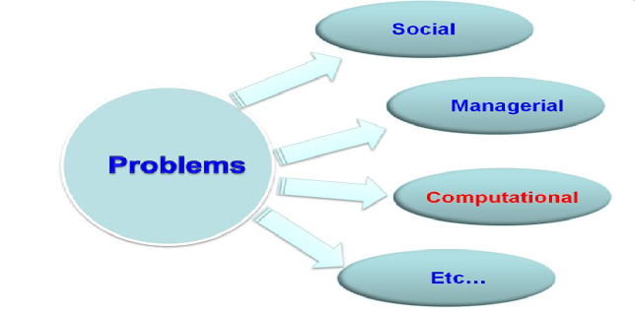
Types of problems

Slide 43
Computational Problems
Definition: Computation is a process of evolution from one state to another in accordance with some rules.

Slide 44
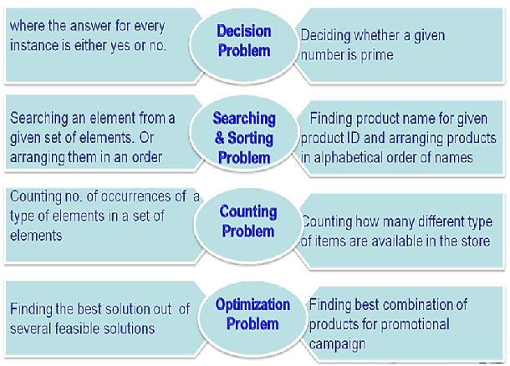
Broad applications of Computational Problem

Slide 45
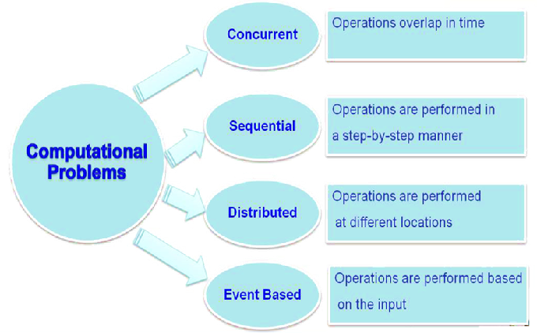
Classification of computational problems

Slide 46

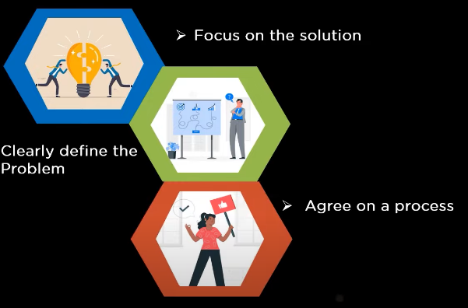
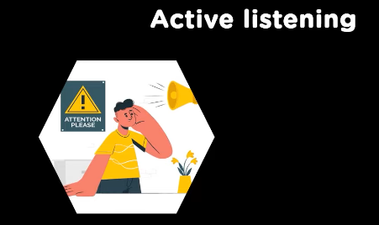

Slide 47
Typical C program development environment
C programs typically go through six phases to be executed. These are: edit, preprocess, compile, link, load and execute
Phase 1 : creating a program
Phases 2 and 3: Preprocessing and Compiling a C Program
Phase 4: Linking
Phase 5: Loading
Phase 6: Execution
Notes:
Phase 1 : creating a program
Phase 1 consists of editing a file.
This is accomplished with an editor program
The editor Named CodeBlocks will be used for creating the program.
You type a C program with the editor, make corrections if necessary, then store the program on a secondary storage device such as a hard disk.
C program file names should end with the .c extension
Phases 2 and 3: Preprocessing and Compiling a C Program
In phase 2, you compile the program.
The compiler translates the C program into machine language-code (also referred to as object code).
In a C system, a preprocessor program executes automatically before the compiler’s translation phase begins.
The C preprocessor obeys special commands called preprocessor directives, which indicate that certain manipulations are to be performed on the program before compilation.
These manipulations usually consist of including other files in the file to be compiled and performing various text replacements.
The most common preprocessor directives are #include, #define etc.
In Phase 3, the compiler translates the C program into machine-language code.
Phase 4: Linking
C programs typically contain references to functions defined elsewhere, such as in the standard libraries or in the private libraries of groups of programmers working on a particular project.
The object code produced by the C compiler typically contains “holes” due to these missing parts.
A linker links the object code with the code for the missing functions to produce an executable image
Phase 5: Loading
Before a program can be executed, the program must first be placed in memory.
This is done by the loader, which takes the executable image from disk and transfers it to memory.
Additional components from shared libraries that support the program are also loaded.
Phase 6: Execution
Finally, the computer, under the control of its CPU, executes the program one instruction at a time.

Slide 48
Thanks

